Slide 1
The Network Layer – Part 1

Slide 2
Contents
Network Layer Design Issues (Chapter 5.1)
The IP Protocol (Chapter 5.6.1)
IP Addresses (Chapter 5.6.2)
Internet Control Protocols (Chapter 5.6.3)

Slide 3
Introduction
The network layer is concerned with getting packets from the source all the way to the destination.
  To achieve its goals, the network layer must know about the topology of the communication subnet (i.e., the set of all routers) and choose appropriate paths through it.
  It must also take care to choose routes to avoid overloading some of the communication lines and routers while leaving others idle.

Slide 4
Network Layer Design Issues
Store-and-Forward Packet Switching
Services Provided to the Transport Layer
Implementation of Connectionless Service
Implementation of Connection-Oriented Service
Comparison of Virtual-Circuit and Datagram Subnets

Slide 5

Store-and-Forward Packet Switching
fig 5-1
The environment of the network layer protocols.

Slide 6
Services Provided to the Transport Layer
The network layer services have been designed with the following goals in mind.
  The services should be independent of the router technology
  The transport layer should be shielded from the number, type, and topology of the routers present
  The network addresses made available to the transport layer should use a uniform numbering plan, even across LANs and WANs
Providing connection-oriented service or connectionless service?

Slide 7

Implementation of Connectionless Service
无连接服务
Routing within a diagram subnet.
Notes:
下面的表：
每个表有两列，第一列表示目的地址，第二列表示出去的线路的编号（出去的端口所对应的线路的编号）
有一个包对应的路由器是A，A不需要发送出去
如果是目的地址是B，那么A就往B送，对应上图的4号线路
如果目的地址是E，那么A只管发送到C，对应3号线路，送到C就不管了，交给路由器C来处理，C有正确的路由表的记录；每一个路由器都只管下一个目的，不管最终目的；因此表信息是否正确至关重要；这个表的信息可以通过人工的方式填进去；或者动态配置，让路由器自己去找
Later表意味着网络中出现问题，链路断后通过人工或路由协议去重新计算出的新的路由表

Slide 8

Implementation of Connection-Oriented Service面向连接服务
Routing within a virtual-circuit subnet.
Notes:
H1和H2这两台主机的网络层之上的程序，需要调H1之上的接口，网络层就负责把连接连起来，然后才能发生数据
H1和H2通信，那么H1会先申请连接，会先给交换设备A发出请求消息；A接到请求消息后，知道H1要和H2建立连接，A会判断这个请求是不是H1发出的第一条消息（因为H1可以同时和H3通信），然后A会给H1分配一个连接号。这个连接请求会带有H2的消息；因为A内部有一个表，所以查表就知道要往H2发送消息，该往哪条路发生消息，如图，明显是C路。A到C连接可能会有很多，因为可能H1要给H3连接，所以也是A到C；所以A要为H1、H2之间的通信建一个段连接，看下图
H1来的数据，如果数据里的字段的连接号为1，那么A就把这个数据往C方向送，然后这个连接号改为1
A再向C发出一个连接请求，这个连接请求会告诉C，这个A要负责在H1、H2之间建立连接，H1、H2之间的连接是H1发给A，连接号为1，A发给C,连接号改为1
从A发来的连接号为1的数据，要发给E，同时把连接编号改为1
因此，A、C、E三个表的第一行形成了一条记录，是H1到H2的连接
H3要跟H2建立连接，连接号为1（1表示H3对外的第一条连接），然后A收到后，要判断这个数据是H1还是H3发的，知道是H3后，转发给C，连接号改为2（查看左一第二行才知道应该往C转发，而且连接号应该改为2）

Slide 9

Comparison of Virtual-Circuit and Datagram Subnets
Comparison of datagram and virtual-circuit subnets

Slide 10
The Network Layer in the Internet(1)
The IP Protocol
IP Addresses
Internet Control Protocols

Slide 11
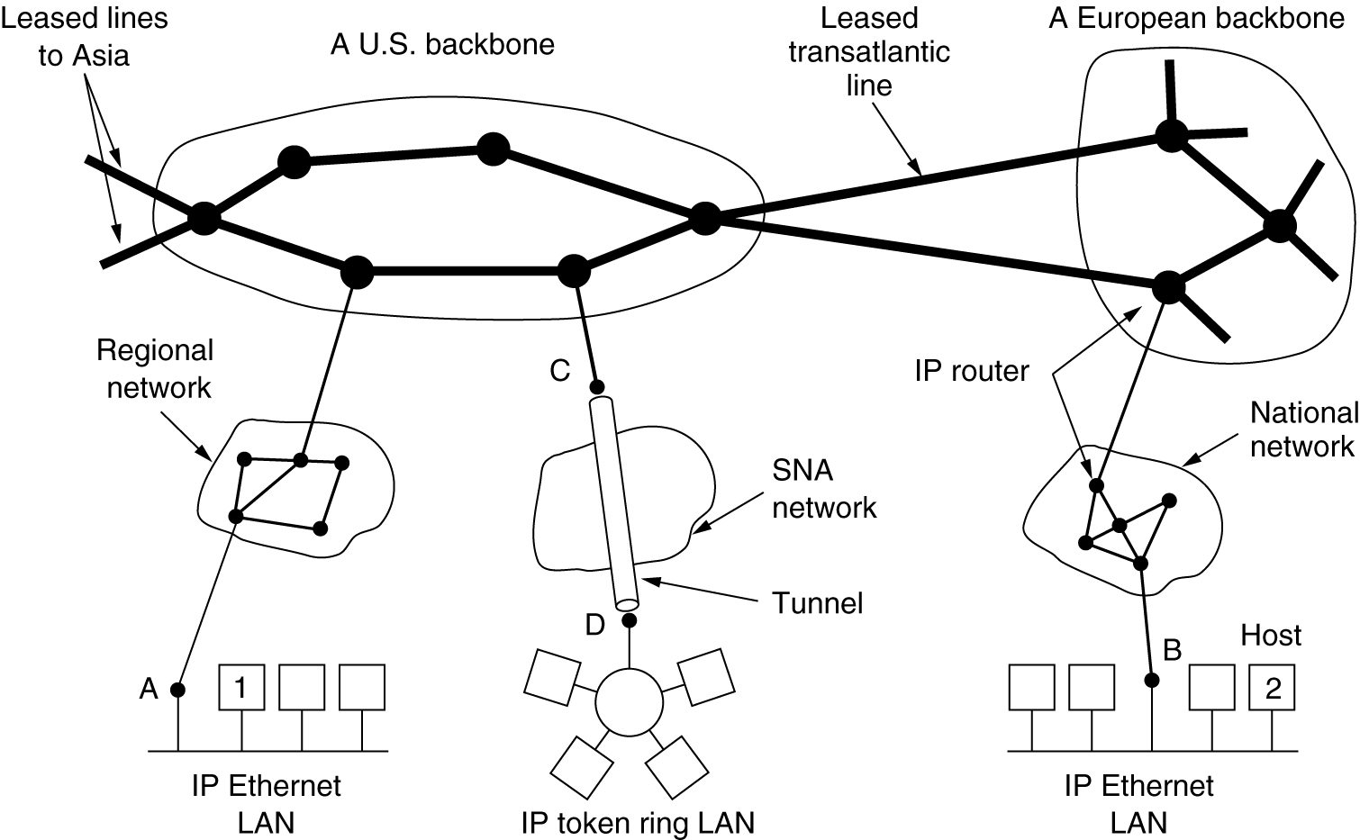
Collection of Subnetworks
The Internet is an interconnected collection of many networks

Slide 12
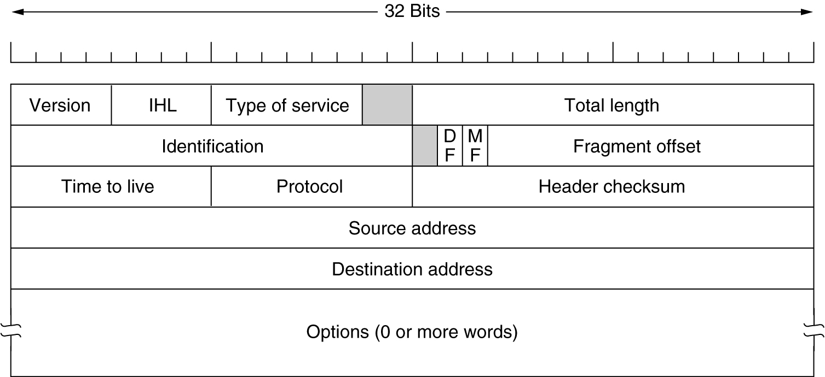
The IP Protocol
The IPv4 (Internet Protocol) header.

Slide 13
number of 32-bit words in the header
3-bit precedence field; 4 TOS bits, and an unused bit set to 0
total length of the IP datagram in bytes
calculated over IP header only
IP Header
uniquely identifies each datagram sent
4-bit
version
4-bit header
length
4-bit type of service
(TOS)
16-bit total length (in bytes)
16-bit identification
0
D
F
M
F
13-bit fragment offset
8-bit time to live
(TTL)
8-bit protocol
16-bit header checksum
20 bytes
32-bit source IP address
upper limit on the number of routers through which a datagram can pass
32-bit destination IP address
option (if any)
data
don’t fragmentation.
turned on for each fragment comprising a datagram except the final fragment.
contains the offset of this fragment from the beginning of the original datagram.
A variable-length list of optional information
Options defined: security and handling restrictions, record route, timestamp, loose source routing, strict source routing
These options are rarely used and not all hosts and routers support all the options
Extracted from TCP/IP Illustrated, Volume 1, by W. Richard Stevens,
Notes:
Protocol字段（8字节）：比如0806是。。协议
Data部分放的是协议的内容
TTL字段：每个包被发送出去，并被路由器接收下来，在被路由器转发出去之前TTL字段会被-1；包里的内容几乎不会变，只会变TTL
-1的目的：防止网络中的路由器路由表有问题，就可能会导致包在几个路由器之间来回转发
Identification：主机在发送包的时候会给包一个序号
字段DF MF Offset：包在网络中传时，路由设备的下一级路由设备不能传送大于某个长度的包，该路由器可将包分为几个小的包，下一级路由就可以转发，达到接收方之后会将它们合并
字段version：表示IP包的IP协议是哪一个版本

Slide 14
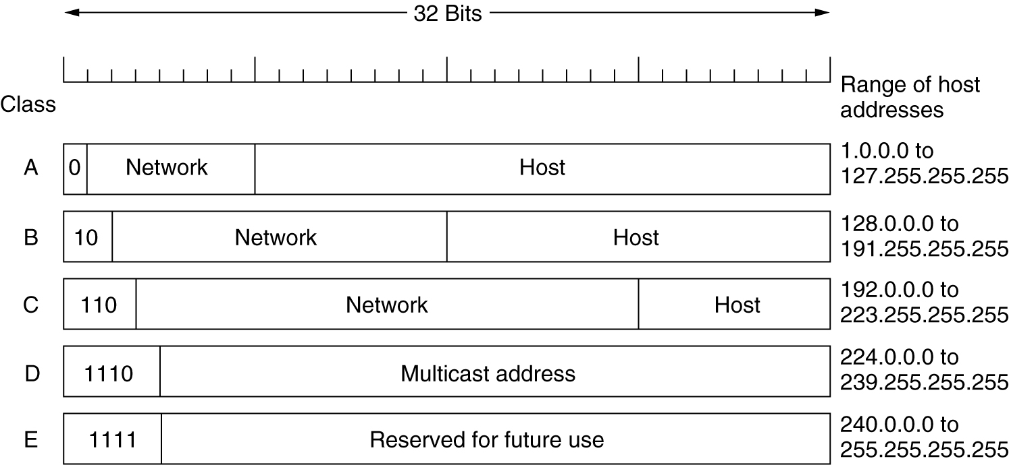
IP Addresses
IP address formats.
Notes:
A类地址：第一个比特取值为0，表示是A类地址；第二到第八个比特（Network）是表示计算机所在的网络的编号；后24个比特( Host )是表示主机在这个网络内部的地址；因此前八个比特相同，后24个比特可以是不同的
IP分配机构是ICANN
B类地址：开头是10，Network部分：网络地址的编号是16个比特
如果地址是全1，那么就表示这个包是要广播到网络中的所有计算机的
如果地址是网络Network填了，但是Host是全1，那么包是要在子网内部广播的

Slide 15
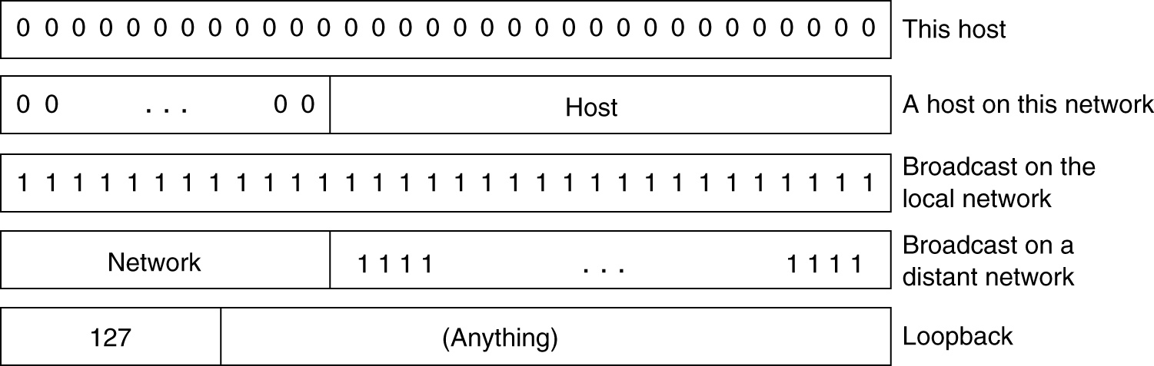
IP Addresses (2)
Special IP addresses.

Slide 16
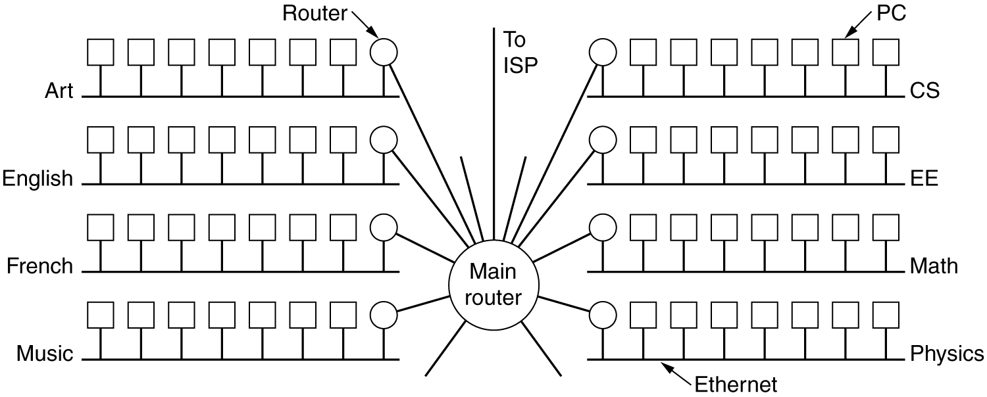
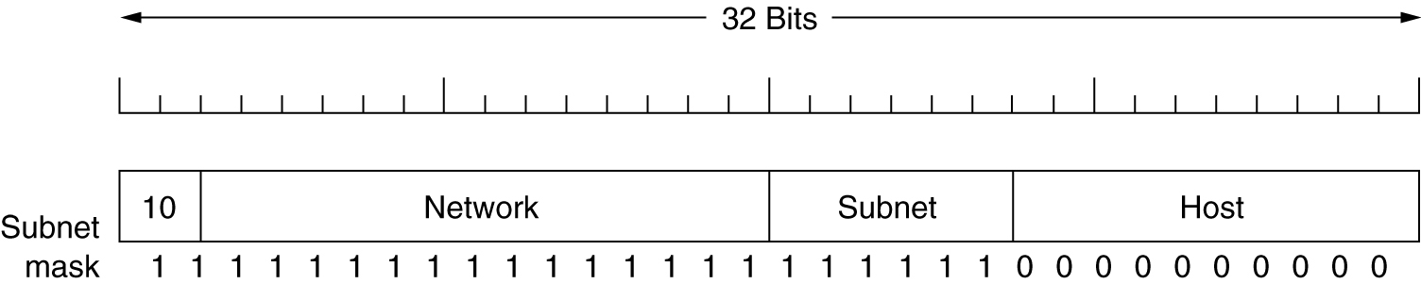
Subnets
Figure 5-57 A campus network consisting of LANs for various departments.
Figure 5-58 A class B network subnetted into 64 subnets.
Notes:
子网掩码：将网络分成多个子网，每个子网有一个ID：网络ID+网络主机ID？
子网掩码有多少个1，就表示了从地址的最左边开始多少位开始是表示子网ID；后面有多少个0，就表示在子网中有多少位来标识子网中的主机

Slide 17
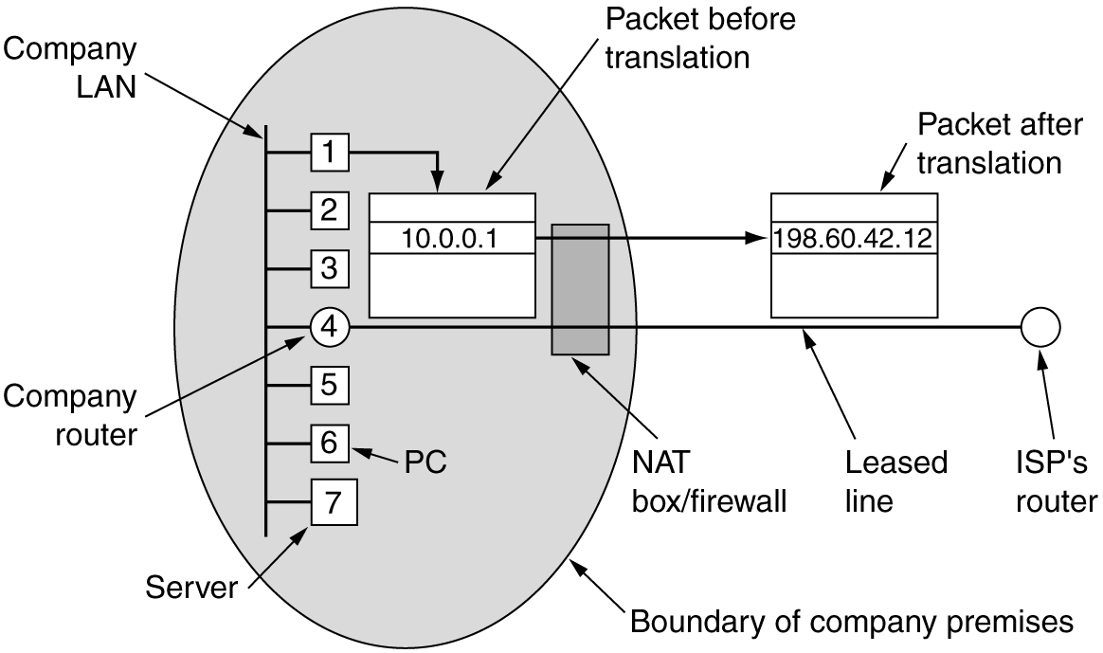
NAT – Network Address Translation
网络地址转换
Placement and operation of a NAT box.
Notes:
网络对外只有一个IP地址，这7台的地址是子网的地址，它们对外只有一个IP地址
如果内网访问外网，内网计算机发出去的包的源地址是内网地址，然后在转换器那里把内网地址转换为外网地址，因为外网中的路由器没有内网地址的记录，如果不改的话就没法送回
通过传输层的端口号去标识发送消息的进程，这样就知道应该回送给哪个进程；每个浏览器都会占用传输层的一个端口号
通过端口号的转化可以找到内网中的计算机

Slide 18
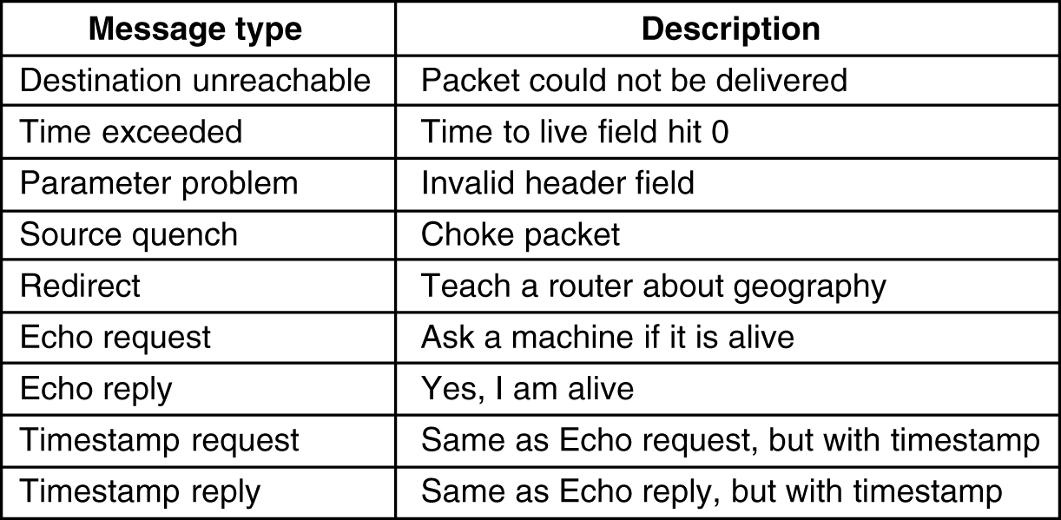
Internet Control Message Protocol
5-61
The principal ICMP message types.
Notes:
ICMP协议：监测网络层的工作状态

Slide 19
IP datagram
IP
header
ICMP message
20 bytes
ICMP messages encapsulated within an IP datagram
0
7
8
15
16
31
8-byte type
8-byte code
16-byte checksum
(contents depends on type and code)
ICMP message
Extracted from TCP/IP Illustrated, Volume 1, by W. Richard Stevens,
Notes:
第一个字节是type：

Slide 20
ICMP error message always contains the IP header and the first 8 bytes of the IP datagram that caused the ICMP error to be generated
type | code | Description | Query | Error
0 | 0 | echo reply(ping reply) | *
3 |  | destination unreachable:
 | 0 | network unreachable |  | *
 | 1 | host unreachable |  | *
 | 2 | protocol unreachable |  | *
 | 3 | port unreachable |  | *
 | 4 | fragmentation needed but don't-fragment bit set |  | *
 | 5 | source route failed |  | *
 | 6 | destination network unknown |  | *
 | 7 | destination host unknown |  | *
 | 8 | source host isolated (obsolete) |  | *
 | 9 | destination network administratively prohibited |  | *
 | 10 | destination host administratively prohibited |  | *
 | 11 | network unreachable for TOS |  | *
 | 12 | host unreachable for TOS |  | *
 | 13 | communication administratively prohibited by filtering |  | *
 | 14 | host precedence violation |  | *
 | 15 | precedence cutoff in effect |  | *
4 | 0 | Source quench(elementary flow control.) |  | *
The ICMP "host unreachable" error message is sent by a router when it receives an IP datagram that it cannot deliver or forward.
ICMP message types (part 1)
Extracted from TCP/IP Illustrated, Volume 1, by W. Richard Stevens,

Slide 21
type | code | Description | Query | Error
5 |  | redirect (Section 9.5):
 | 0 | redirect for network |  | *
 | 1 | redirect for host |  | *
 | 2 | redirect for type-of-service and network |  | *
 | 3 | redirect for type-of-service and host |  | *
8 | 0 | echo request (Ping request) | *
9 | 0 | router advertisement | *
10 | 0 | router solicitation | *
11 |  | time exceeded:
 | 0 | time-to-live equals 0 during transit (Traceroute) |  | *
 | 1 | time-to-live equals 0 during reassembly |  | *
12 |  | parameter problem:
 | 0 | IP header bad (catchall error) |  | *
 | 1 | required option missing |  | *
13 | 0 | timestamp request | *
14 | 0 | timestamp reply | *
15 | 0 | information request (obsolete) | *
16 | 0 | information reply (obsolete) | *
17 | 0 | address mask request | *
18 | 0 | address mask reply | *
The ICMP timestamp request allows a system to query another for the current time.
The ICMP address mask request is intended for a diskless system to obtain its subnet mask
ICMP message types (part 2)
Extracted from TCP/IP Illustrated, Volume 1, by W. Richard Stevens,

Slide 22
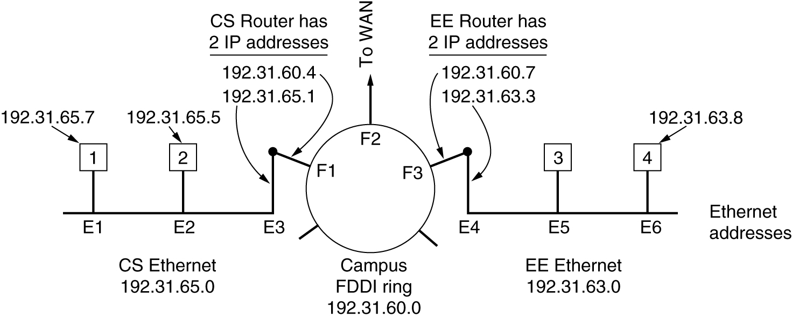
ARP– The Address Resolution Protocol
Three interconnected /24 networks: two Ethernets and an FDDI ring.

Slide 23
=1: for Ethernet
= 0x0800: for IP address
hard size
prot size
= 0x0806
=1: ARP request; =2: ARP reply (2);
=3: RARP request; =4: RARP reply
Ethernet
destination
addr
Ethernet
source
addr
frame
type
hard
type
prot
type
op
Sender
Ethernet
addr
sender
IP addr
target
Ethernet
addr
target
IP addr
6
6
2
2
2
1
1
2
6
4
6
4
Ethernet header
28 bytes ARP request/reply
Figure 4.3 Format of ARP request or reply packet when used on an Ethernet
The special Ethernet destination address of all one bits means the broadcast address.

Slide 24
RARP, BOOTP, and DHCP
RARP(Reverse Address Resolution Protocol ) :
  for the diskless system to ask for IP address (in an RARP reply).
  uses a destination address of all 1s (limited broadcasting) to reach the RARP server,
  such broadcasts are not forwarded by routers, so a RARP server is needed on each network
BOOTP:
  BOOTP uses UDP messages, which are forwarded over routers
  A serious problem with BOOTP is that it requires manual configuration of tables mapping IP address to Ethernet address.
DHCP(Dynamic Host Configuration Protocol ):
  DHCP allows both manual IP address assignment and automatic assignment.

Slide 25
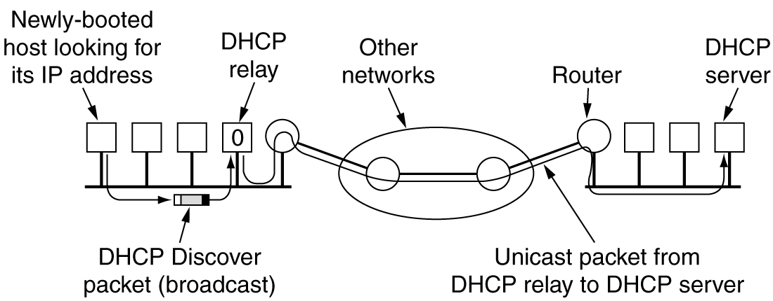
Dynamic Host Configuration Protocol
Operation of DHCP.

Slide 26
Summary
The function of the network layer
Network Layer Design Issues
  Store-and-Forward Packet Switching
  Services Provided to the Transport Layer: connectionless service, connection-oriented service
  Datagram, virtual-circuit
  Routing table in datagram subnet, and in virtual-circuit subnet
Internet:
  Autonomous System(AS)
  Internet Network Layer Protocol: Internet Protocol(IP), ICMP, ARP
Internet Protocol(IP)
  The IPv4 (Internet Protocol) header: the meaning and function of the fields in the IPv4 header
  IP Address: different classes of IP address,
  Subnet
  NAT
ICMP: the function of the ICMP
ARP:
  The function of the ARP
  How to do the IP address to MAC address mapping in the Ethernet?
RARP, BOOTP, and DHCP: the function of these protocols

